Slide 1

COMP 7500/7506 Advanced Operating Systems
Message Queues and RPC
Dr. Xiao Qin
Auburn University http://www.eng.auburn.edu/~xqin
xqin@auburn.edu
Notes:
2021Spring
50 min: slides 1-29
See also (1) COMP3500 07b process control (2) COMP3500 31b-scheduling
Reference: http://slideplayer.com/slide/4976336/
2018 Spring
50 Minutes: Slides 1-16=11-26

Slide 2







Messaging Queues for Building Distributed Systems
Notes:
https://stackoverflow.com/questions/731233/activemq-or-rabbitmq-or-zeromq-or
RabbitMQ is one of the leading implementation of the AMQP protocol (along with Apache Qpid). Therefore, it implements a broker architecture, meaning that messages are queued on a central node before being sent to clients. This approach makes RabbitMQ very easy to use and deploy, because advanced scenarios like routing, load balancing or persistent message queuing are supported in just a few lines of code. However, it also makes it less scalable and “slower” because the central node adds latency and message envelopes are quite big.
ZeroMq is a very lightweight messaging system specially designed for high throughput/low latency scenarios like the one you can find in the financial world. Zmq supports many advanced messaging scenarios but contrary to RabbitMQ, you’ll have to implement most of them yourself by combining various pieces of the framework (e.g : sockets and devices). Zmq is very flexible but you’ll have to study the 80 pages or so of the guide (which I recommend reading for anybody writing distributed system, even if you don’t use Zmq) before being able to do anything more complicated than sending messages between 2 peers.
ActiveMQ is in the middle ground. Like Zmq, it can be deployed with both broker and P2P topologies. Like RabbitMQ, it’s easier to implement advanced scenarios but usually at the cost of raw performance. It’s the Swiss army knife of messaging :-).
Finally, all 3 products:
have client apis for the most common languages (C++, Java, .Net, Python, Php, Ruby, …)
have strong documentation
are actively supported

Slide 3
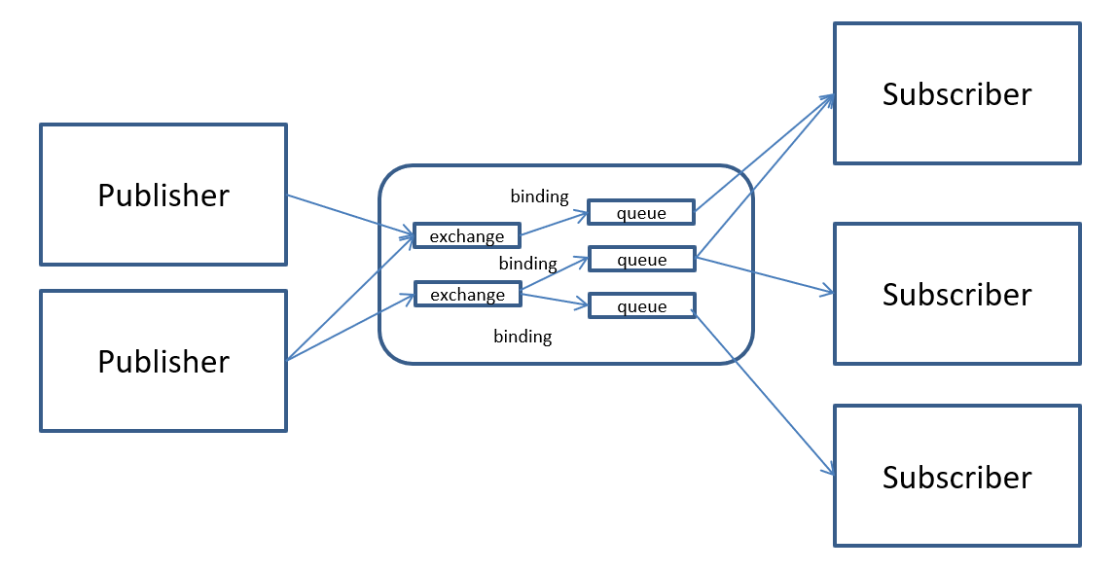
RabbitMQ Overview
Notes:
AMQP: Advanced Message Queuing Protocol

Slide 4
Notes:
Each message can be published with a routing key
Each binding between an exchange and a queue has a binding key
Routing of messages is determined based on matching between the routing and binding keys

Slide 5
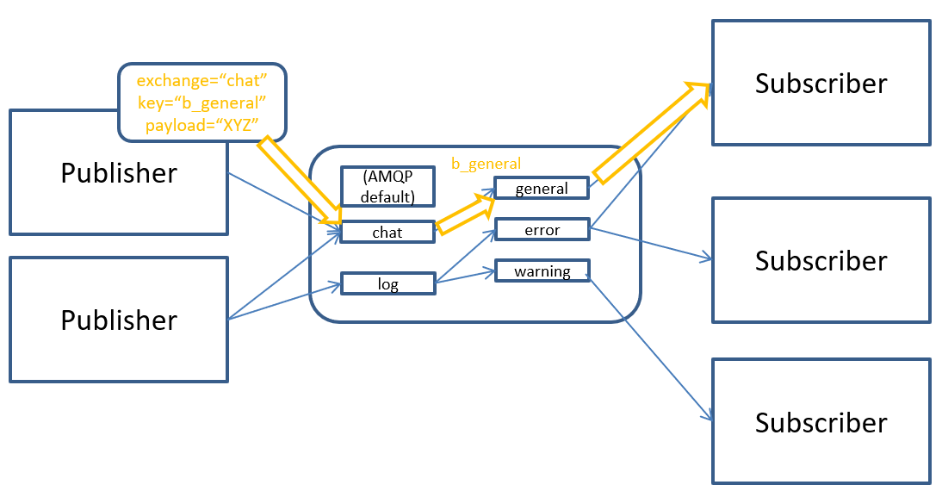
RabbitMQ: Direct Exchange
Notes:
AMQP: Advanced Message Queuing Protocol

Slide 6
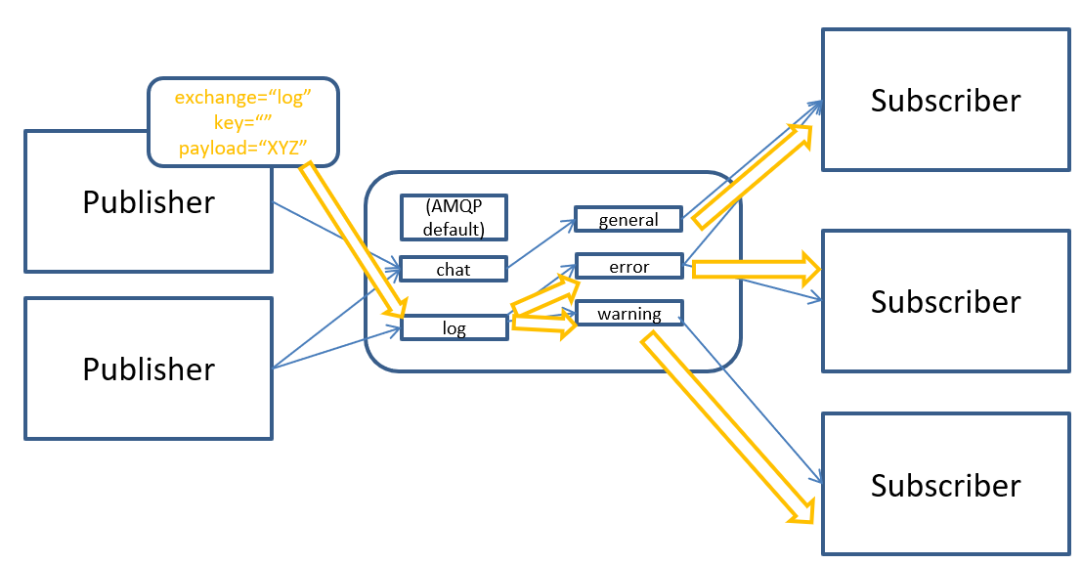
RabbitMQ: Fanout Exchange
Notes:
AMQP: Advanced Message Queuing Protocol

Slide 7
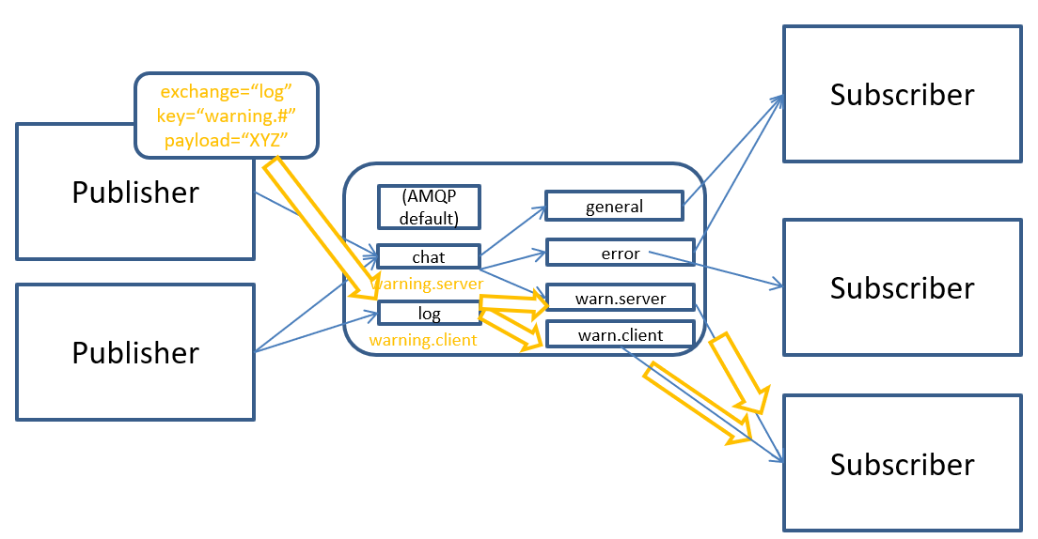
RabbitMQ: Topic Exchange
Notes:
AMQP: Advanced Message Queuing Protocol

Slide 8


Slide 9
Amazon SQS
SQS Queue
Create an infinite
asynchronous queue.
Message 1
…
Message N
Main Features:
Multiple queues
Upto 4K messages
Message Locking
Send
Message
Receive
Message
Writer
Reader
Notes:
Amazon provides SDKs in several programming languages including Java, Ruby, Python, . NET, PHP and JavaScript.
https://medium.com/@drwtech/a-node-js-introduction-to-amazon-simple-queue-service-sqs-9c0edf866eca

Slide 10
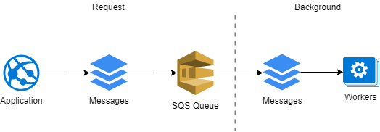
Amazon SQS
Notes:
https://medium.com/@drwtech/a-node-js-introduction-to-amazon-simple-queue-service-sqs-9c0edf866eca

Slide 11
RPC Frameworks in Modern Systems
Google: https://grpc.io
Facebook: https://github.com/facebook/fbthrift
Notes:
https://stackoverflow.com/questions/731233/activemq-or-rabbitmq-or-zeromq-or
https://thrift.apache.org

Slide 12
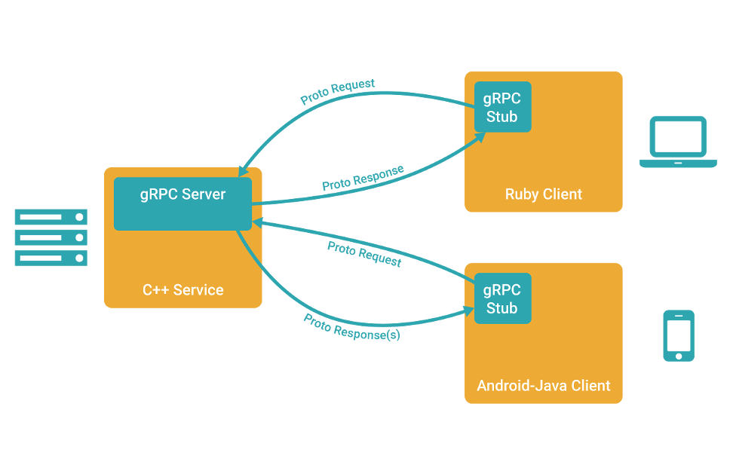
Credit: https://grpc.io/

Slide 13
gRPC Basics
Define a service in a .proto file.
Generate server and client code using the protocol buffer compiler.
Use the C++ gRPC API to write a simple client and server for your service.
https://grpc.io/docs/tutorials/basic/cpp/
Notes:
https://grpc.io/docs/tutorials/basic/cpp/

Slide 14
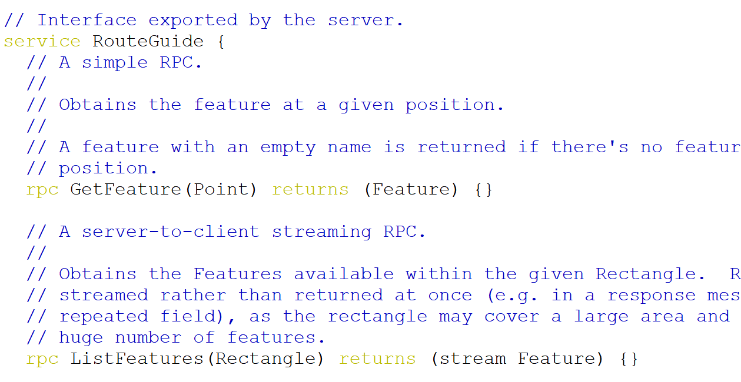
The .proto File

Slide 15
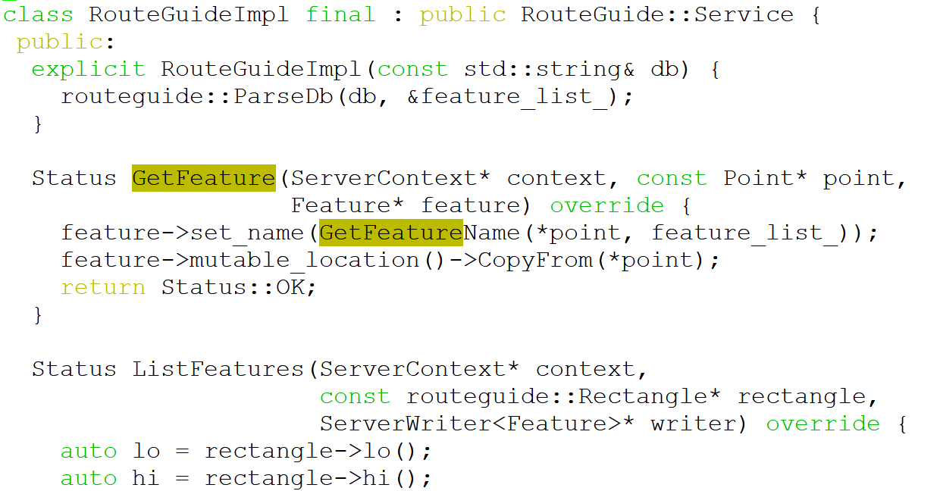
route_guide_server.cc

Slide 16
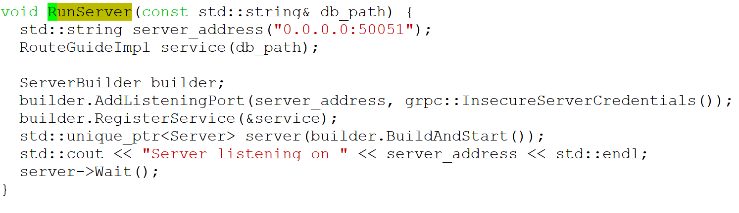
route_guide_server.cc

Slide 17
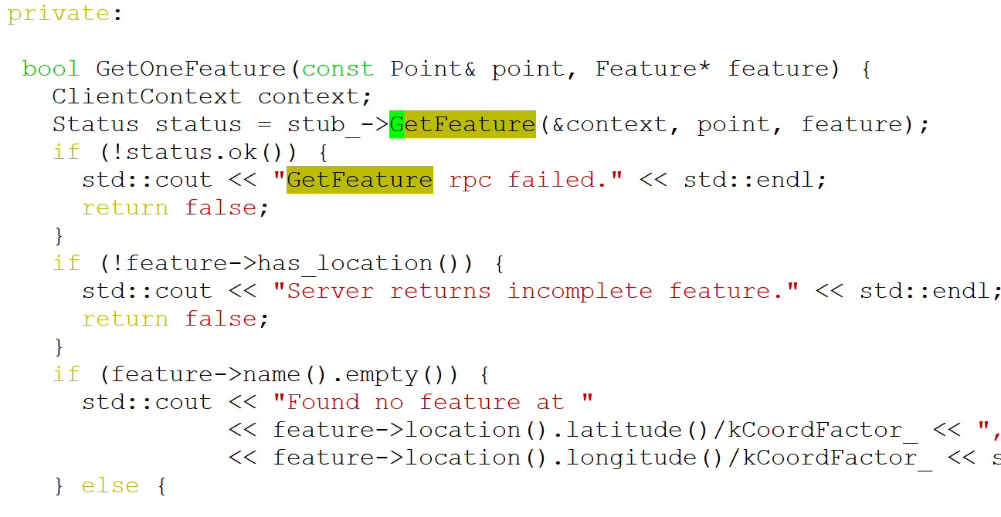
route_guide_client.cc

Slide 18
COMP 7500/7506 Advanced Operating Systems
Basic Scheduling Concepts
Dr. Xiao Qin
Auburn University http://www.eng.auburn.edu/~xqin
xqin@auburn.edu
Notes:
See also (1) COMP3500 07b process control (2) COMP3500 31b-scheduling
Reference: http://slideplayer.com/slide/4976336/
2018 Spring
50 Minutes: Slides 1-16=11-26

Slide 19
Learning Objectives
Basics
Criteria
Scheduling Criteria
Basic Concepts
Policy
Scheduling Algorithms
Notes:
Overview
Basic idea of “multi-level queue scheduling”

Slide 20

Job Interview Questions
Design a job scheduler.
Notes:
Reference: https://www.careercup.com/question?id=5104497948884992
https://www.glassdoor.ca/Interview/Truck-scheduling-problem-QTN_263353.htm

Slide 21
Exercise 1 (Menti): What is a process?
It is an application to be loaded into CPU.
It is a program stored on a file system.
It is an application stored on a file system.
It is an instance of a program in execution.

Slide 22
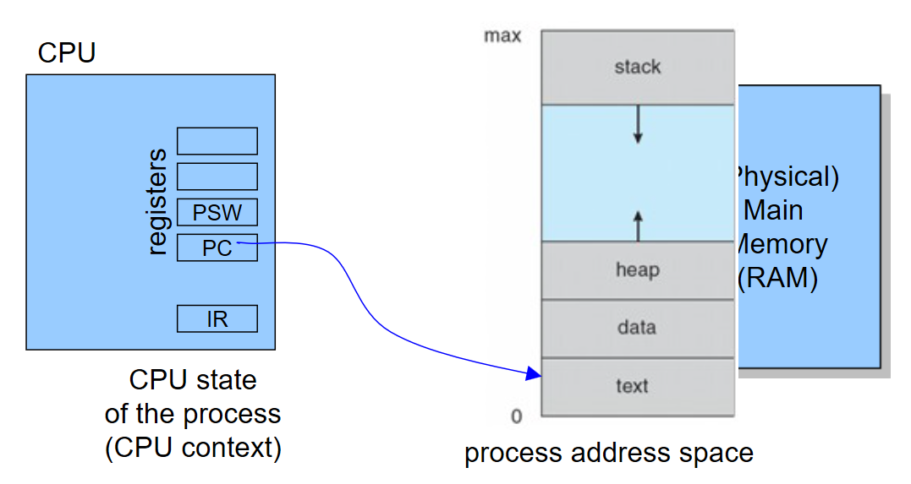
What is Process Context?
Notes:
Process context is the minimal set of data used by a process that must be saved to allow the process to be interrupted, and later continued from the same point.

Slide 23
Exercise 2 (Menti): Which statement is incorrect about context switch?
It stores the state of a running process
It resumes the execution of a ready process
It allows multiple CPUs to share resources
It is an essential feature of a multi-tasking operating system.

Slide 24
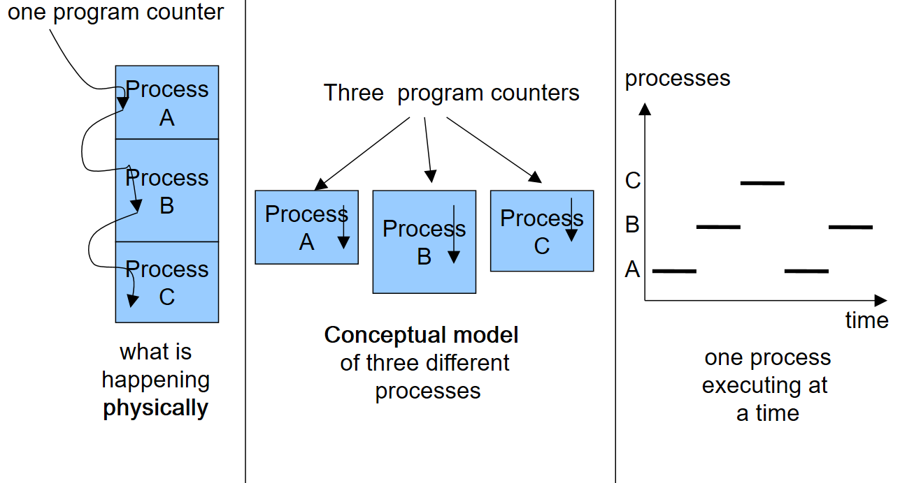
Context Switch

Slide 25
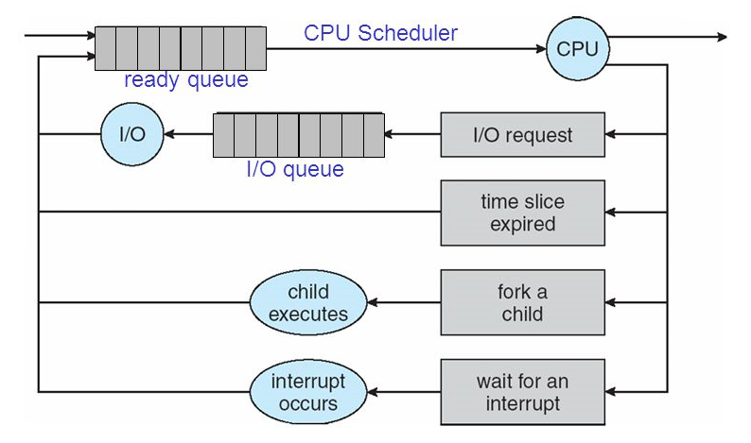
Exercise 3: Please design a process scheduling system diagram (Hint: two queues, one scheduler)

Slide 26
Exercise 4: What are reasons for running processes to cease using a CPU? Please write down at least two reasons.
Notes:
Time out
Wait for I/Os
Be preempted
Done
Wait for event (synchronization)

Slide 27
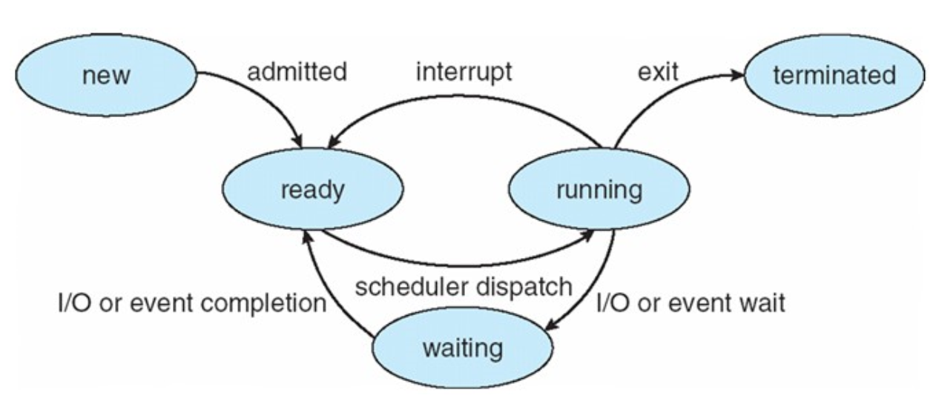
Five-State Process Model
Notes:
Time out
Wait for I/Os
Be preempted
Done
Wait for event (synchronization)

Slide 28
Exercise 5: What is the data structure of items in the ready queue and I/O queue?

Slide 29
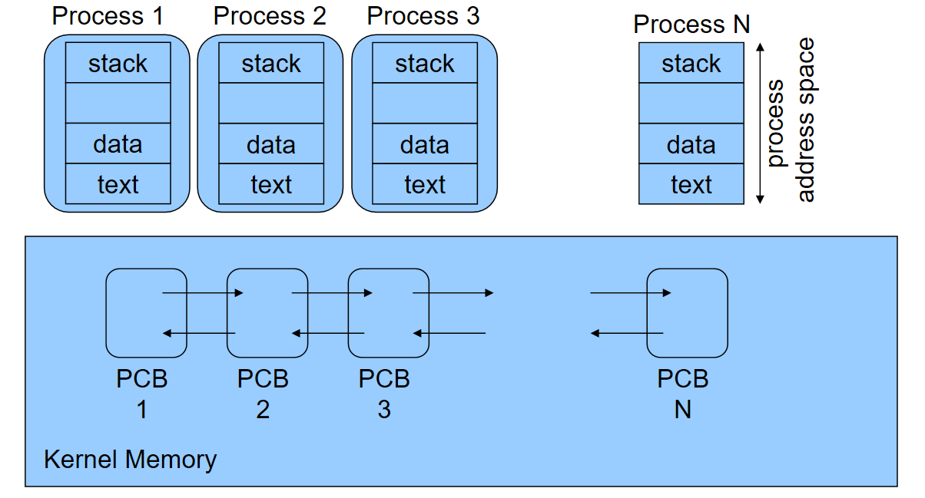
Notes:
PCB in Linux: include/linux/sched.h,
task_struct

Slide 30

Wait Time vs. Turnaround Time
Let P = {p_{i} | 0 ≤ i < n} = set of processes
Let S(p_{i}) ∈ {running, ready, blocked}
Let t(p_{i}) = Time process needs to be in running state (the service time)
Let W(p_{i}) = Time p_{i} is in ready state before first transition to running (wait time)
Let T_{TRnd}(p_{i}) = Time from p_{i} first enter ready to
last exit ready (turnaround time)
Batch Throughput rate = inverse of avg T_{TRnd}
Timesharing response time = W(p_{i})

Slide 31
Exercise 6 (Plickers): The system objectives of processor scheduling include the following ones except:
Reduce wait time
Improve throughput
Minimize context switch overhead
Optimize processor efficiency
Notes:
See also “Reduce response time”

Slide 32
Exercise 7 (Plickers): The shortest job next scheduling algorithm schedules the following five jobs. (7.1) What is the average turn around time? A. 315 B. 600 C. 560 D. 480 (7.2) What is the average waiting time? A. 285 B. 320 C. 410 D. 305 i 0 1 2 3 4 t(pi) 350, 125, 475, 250, 75
Notes:
Time out
Wait for I/Os
Be preempted
Done
Wait for event (synchronization)

Slide 33

Summary
What are process, process context, and context switch?
What are scheduling criteria?
Reading Assignment: Chapter 6.1-6.3.4 page 261-273.

